Slide 1
Lord of the Flies Island Map
Using abstraction to visually represent a story

Slide 2
Island Map Project
You and your partner are going to create a map of the island.
Your goal is to use abstraction, a computational thinking skill, to determine which locations and events are most important in visually telling the story of Lord of the Flies.

Slide 3
Required elements
Your map must include at least five locations and at least five events, all of which must be labeled.
Brainstorm what elements you want to include on your map and list them on the handout, including the page number from where you will find your evidence.

Slide 4
Required elements (continued)
Your map must also include one quote from the novel that relates to one of the central themes. Select your quote (make sure it’s not too long!) and copy it onto your handout, including what page it can be found on.

Slide 5
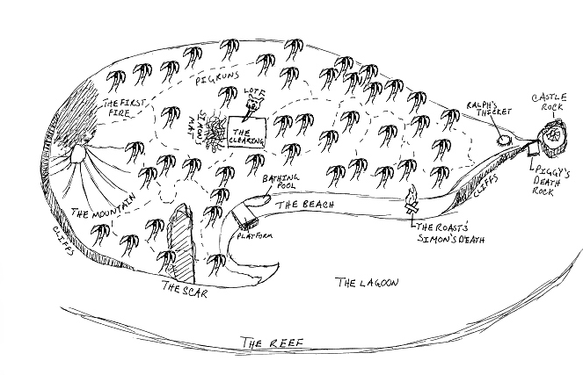

Slide 6
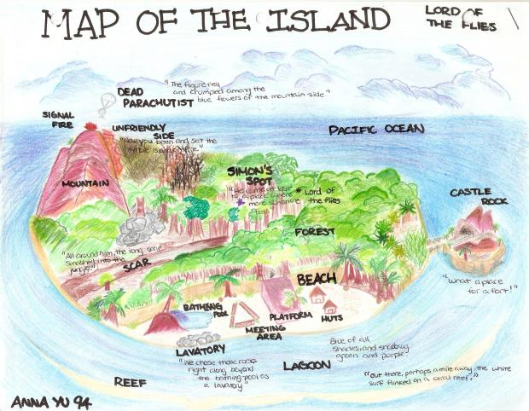

Slide 7
 | Developing (1-3pts) | Proficient (4-7pts) | Advanced (8-10pts)
Element selection | Most of the required components are included Some chosen elements are important to the story, but many important elements are missing Included quote does not relate to a central theme | All of the required components are included Most chosen elements are important to the story, and few important elements are missing Included quote somewhat relates to a central theme | All of the required components are included All chosen elements are important to the story, and very few or no important elements are missing Included quote strongly relates to a central theme
Accuracy and neatness | Map doesn’t honor descriptions from the novel Element labels are missing, hard to read or misspelled | Map mostly honors descriptions from the novel No element labels are missing, but a few are misspelled or hard to read | Map strongly honors descriptions from the novel No element labels are missing or misspelled, and all are easy to read
Creativity and effort | The map looks rushed Little to no originality or creativity demonstrated | The map shows some evidence of effort and time Some originality and creativity demonstrated | The map shows significant evidence of effort and time Lots of originality and creativity demonstrated

